Slide 1
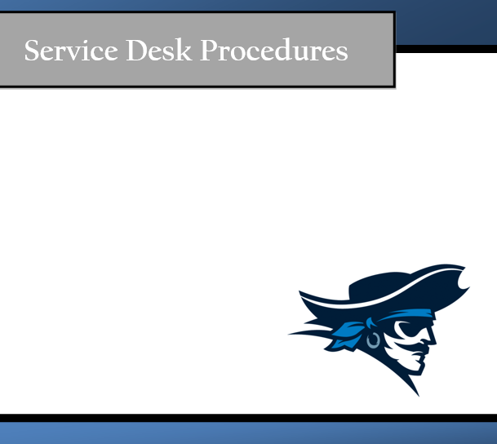

By Chase, Evelyn, Prisca, Jacob, & Brendan

Slide 2
Mission Statement
The mission of the Iowa Western Community College (IWCC) Help Desk is to assist in upping our internal and external user communities by enabling our users through making Information Technology resources readily available and accessible. We achieve this by providing assistance with electronic devices such as but not limited to; Smartphones, Tablet PCs, Apple iOS, and Netbooks in a single point of contact for customer-focused, quality services and support.

Slide 3
Help Desk Goals
Provide a timely and accurate statues update
Inform customer on request status and progress
Deliver high quality service
Monitor calls
Produce measurements and metrics
Ensuring users satisfaction

Slide 4
Service Level Agreement (SLA)
Availability- Will be open on Monday through Friday 9am-5pm. Will be close on holidays.
Tickets- Reassigning ticket to a new agent if it’s past over due.
Contacts- Will contact customers through e-mail, phone calls, and voice messages.
Reliability- Won’t be open on school breaks and holidays.
Performance- Will not keep customers waiting anymore then 2 minutes.
Security- Strong passwords will be used to access services.
Charging- Free for IWCC students.

Slide 5
Email and Internet Usage Policy
Email and internet extensions are assigned to an employee’s computer for the sole purpose of conducting company business. Some assignments and responsibilities at the help desk require access to the internet and email. Only technicians that are appropriately authorized, for company purposes, may use the internet to access and download any needed, additional software.
Email is also to be used for company/help desk business only. You are not to conduct any personal business using company computers or email. Non-business related emails waste company and employee time and attention. Any email content that discriminates any protected classification including age, race, color, religion, sec, national origin, disability, genetic information, sexual preference and even weight is prohibited.
Keep in mind that the company owns any communication that is sent via email or otherwise stored on company equipment, such as computers, flash drives, or external hard drives. Management and other authorized staff have the right to access your email or material on your computer at any time. Please do not consider your electronic communication, storage, connection, or access to be private if it is created or stored on work systems and servers.
Internet use on company time using devices that are connected to the company network is authorized to conduct company business only. Internet use also creates the possibility of contamination in our system via viruses, malware, and spyware. For this reason, and to assure the use of work time appropriately for work, we ask technicians to limit internet use.

Slide 6
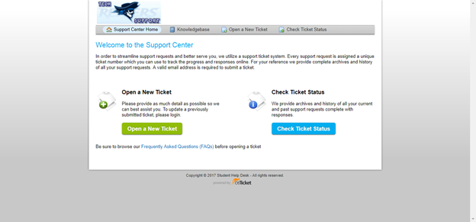
osTicket- Accessing the Site
osTicket is the ticket request system used for customers to request for services from the help desk. On the osTicket website, a technician can manage inquiries, messages, incoming tickets, the FAQ, and much more.
To access the site as a customer, open a web browser and type: http://pcsupport.ecc.iwcc.edu/ The webpage should look like this:

Slide 7
osTicket- Opening a New Ticket
To create a new ticket:
1. After logging into the osTicket site, click on “New Ticket” at the top of the tickets list page.
2. On the “Open a New Ticket” page, you must fill in the customer and ticket information:
3. Below the information boxes, you will describe the issue. Here is where you will title the issue by using a short issue summary and describe the issue in full detail within this box. After defining the issue, you will define a priority level. How urgent is the issue? Is it something that needs to be solved immediately or could do with taking a few days to solve?
4. Once the issue has been defined, it is time to choose a response for the ticket. After deciding on a ticket response, you will choose whether to keep the ticket open or close the ticket
5. Internal notes will be notes only seen by other technicians. If you have any input or advice about the issue, here is where you would communicate it to the technician assigned to the ticket.
6. Once you have all the information in order, click “Open.” Your new ticket should appear in the open tickets section of osTicket.

Slide 8
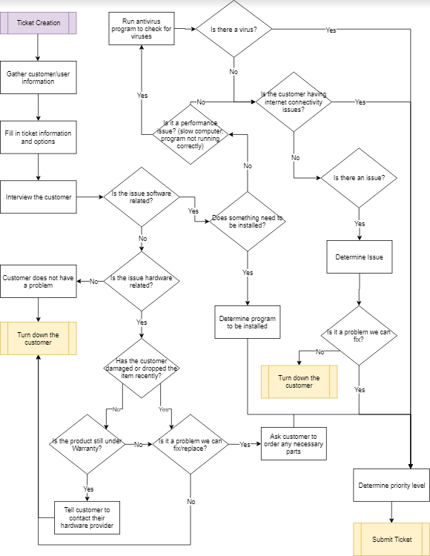
Ticket Creation Information Process Map

Slide 9
Ticket Management
As a technician, you may have to do some ticket management, which would include reassigning tickets, viewing and adding internal notes, changing the due date or ticket status, etc.
Tickets Front Page
On the front page, you will be able to see general information about open, closed, and overdue tickets.
Beginning on the left hand side, you will see the ticket numbers. This is used as a reference for the specific ticket you or the customer may be looking for. Each number is unique to the case it represents so there are no two alike numbers.
Ticket Thread
When you click on a ticket number, it will open up the ticket thread. Here, you will see general ticket info, ticket status, priority, ticket creation, due date, technician assigned, customer name and contact info.

Slide 10
Ticket Management (Cont’d)
Below the ticket information box is the ticket thread. The ticket thread will display all the internal messages between technicians and automated messages by the system, such as ticket overdue messages. These messages are color coded as such:
Blue - Initial message describing the issue
Yellow - Internal messages by the technicians and system
Orange - Reply messages sent to the customer with the ticket
Responding, Resolving, Closing
Under the ticket thread, you are able to post your own replies to the customer by selecting “Post Reply.”.
If you select “Post Internal Note” you can post replies that only technicians will be able to see. This is useful in asking for or giving advice in order to resolve an issue quicker. From both these tabs, you can also change the status of the ticket from Open to Waiting Response, Resolved or Closed.

Slide 11
Using the FAQ
Our osTicket site provides a technician operated knowledge base, or more commonly referred to as an FAQ (Frequently Asked Questions). This is useful for any common issues or questions that arise, they can be put in the the FAQ for others to use.
This is not only visible to technicians but can also be made visible to customers. Rather than customers bringing in their device for any small issue, they can first browse the FAQ knowledgebase for an answer to their problem.
To access the FAQ, click on the “Knowledgebase” tab at the top of the page. It’ll bring you to the FAQ forum.
From this page you can browse the categories for more information on how to solve an issue, granted it is kept updated frequently.
As more common issues and questions arrive, it may be useful to you and your fellow technicians to add your own expertise to the FAQ.

Slide 12
Adding on to the FAQ’s
To add on to the FAQ:
1. Select the category in which your topic belongs to. If there is not a category created for your topic, select the closest one or create a new one by selecting “Categories”
From this page, select “Add New Category” provide the new Category Name, Description, Internal Notes, and Category Type (Public or Private). Once you have provided the necessary info, click “Add”.
2. Once you have chosen or created your category, on the “FAQ” page, select the category you decided or created. On the next page, you will select “Add New FAQ” to add on to the list of Frequently Asked Questions.
3. From here, you must specify the question that is being answered. The category listing should be left the same as it is the category you originally selected, however if you made a mistake, it can also be changed from this page.
You can also choose whether the FAQ will be visible to customers (public) or only to technicians (internal). Once all your FAQ information is in order, click "Add FAQ”

Slide 13
Setting Up New Users
Sometimes a customer may have more issues in the future and decide to come back. By creating a user account for them, it’ll speed up the process of submitting a ticket. The “Users” tab houses all of the user’s guest and registered accounts in the system.
To register an account already in the system, click on the user you would like to register, and click “Register” in the top right.
This will bring up a window to which you can create the user’s username and create their new account.
If by chance the user is not in the system, you can set up a new user by scratch by clicking on “Add User” from the User Directory.

Slide 14
Ticket Assignment Policy
As tickets are made, the must be assigned to a technician in order to be resolved and closed. But what technicians will take what tickets? This may also be a matter of which technician is trained in what areas, otherwise known as specialists. One technician may know more about hardware problems than others, hence, they would receive a hardware issue ticket.
As we do not have an automatic ticket assignment process available, the ticket should be submitted without assignment and allow all agents to provide input and decide ticket assignment. It will also allow the technician with better knowledge about a certain topic to claim the ticket rather than have it automatically assigned to another technician that may not know as much.
This method requires all analysts to be alert to when a ticket comes in as to not dissatisfy the customer. Tickets should be monitored by a supervisor to assure they are being claimed by technicians in a timely manner.

Slide 15
Backup Policy
To protect against any event that may cause a loss in data, such as physical disaster or data corruption, the help desk requires a periodical backup of all data. The purpose of this policy is to define the minimum controls required for data backup and to safeguard against the loss of data that may occur due to physical disaster, human error, and software or hardware corruption. This policy applies to all technicians who process or store data within the servers.
There are plenty of different backup options, however, they can only be done at specific times. A Full Backup includes all files of a defined set of data. This copies all files, regardless of whether they have been modified or not. This will set the base for the differential and incremental backups. A full backup will only be done once a week to avoid service interruption, followed by differential and/or incremental backups during the week.
An incremental backup captures only the files changed since the last incremental backup. This means the next time an incremental backup is done, the file is skipped unless it has been modified again. This backup option ensures your backup is up to date and saves both time and storage space.
A differential backup captures only the files that have changed since the last full backup. It will continue to backup files that have changed or added since the last full backup. This requires more storage space, but ensures a smoother, easier, and more reliable restore.

Slide 16
Customer Satisfaction Survery
We want to know what you think! Please provide feedback on your experience and help us improve our service.
On a scale of 1 - 5 (1 = low, 5 = high) please rate the following.
Please use NA for any question that is not applicable.
____The availability of help desk staff/ability to reach them in a timely manner?
____The speed in which your question or incident was resolved?
____The timeliness of updates regarding the status of your issue?
____The quality of service you received?
____The friendliness of the analyst(s) that assisted you?
____The overall service you received?

Slide 17
Customer Satisfaction Survery (Cont’d)
Do you have any extra comments, suggestions, or concerns?
__________________________________________________________________________________________________________________________________________________________________________________________________________________________________________
If you would like to be contacted again by a manager, please provide an email or phone number. (Optional)
Email ________________________________________________________________________
Phone number ________________________________________________________________

Slide 18
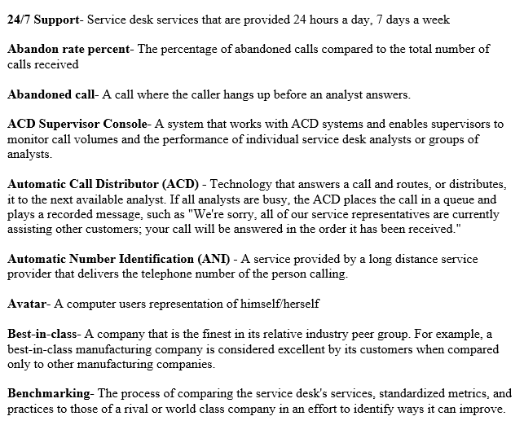
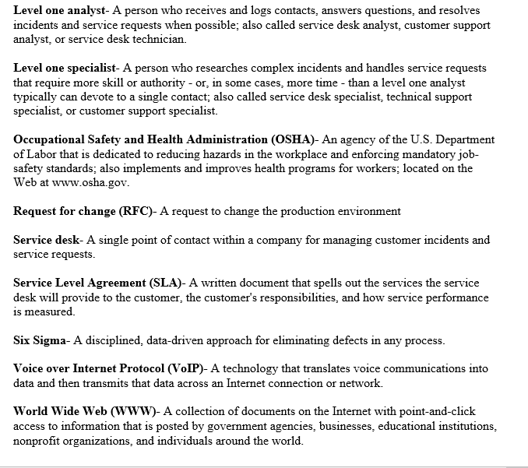
Help Desk Terminology

